Slide 1

Modern Control Theory
Lecture No. 21
Monte Carlo Techniques
Introduction to the Concept of Particle Filters

Slide 2
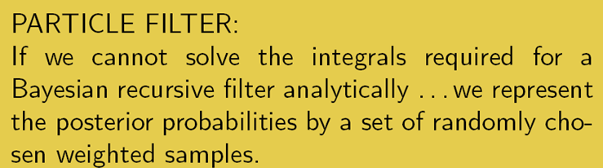
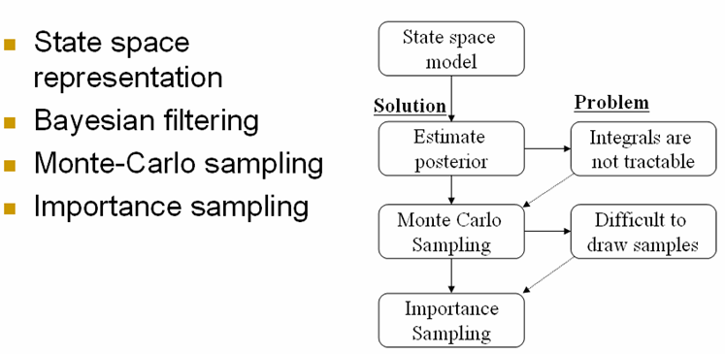

Slide 3

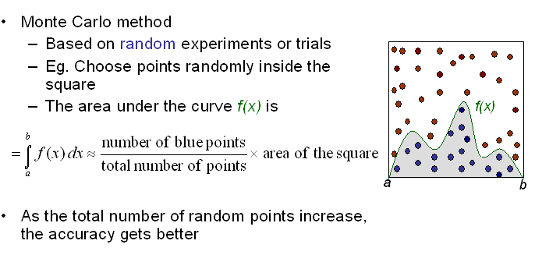

Slide 4
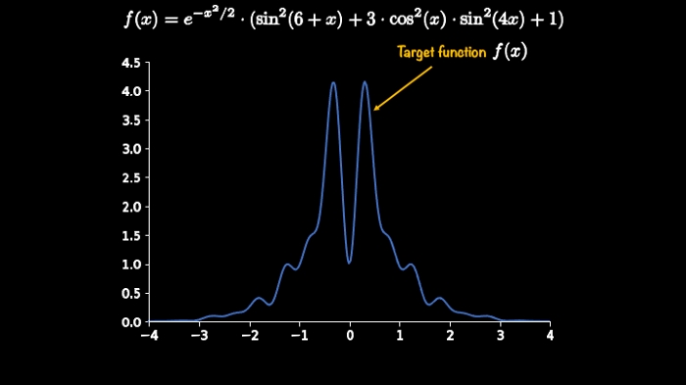
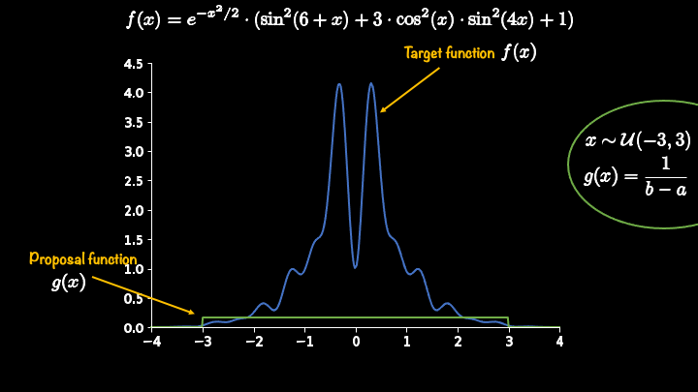
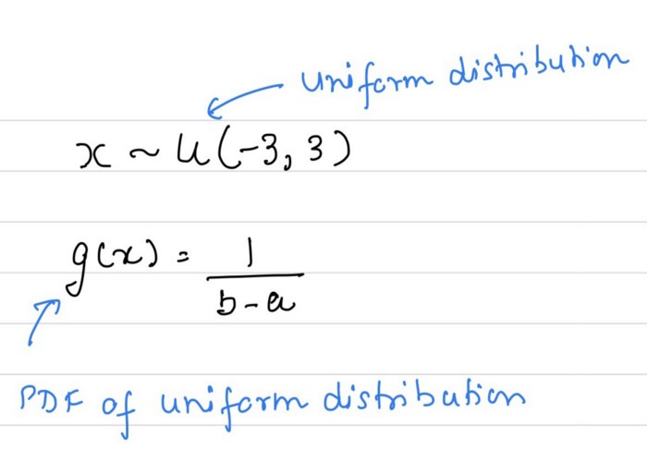
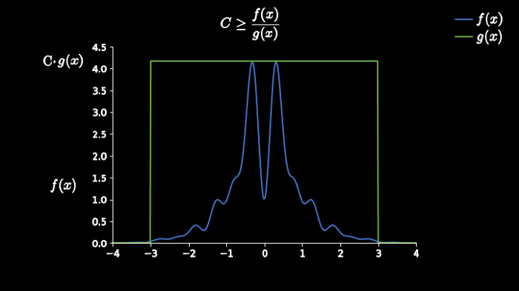
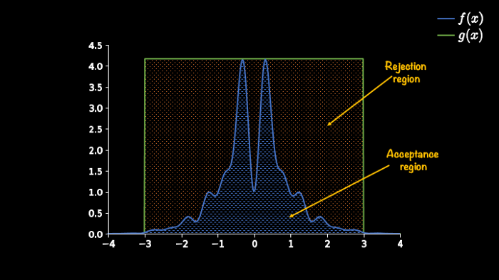
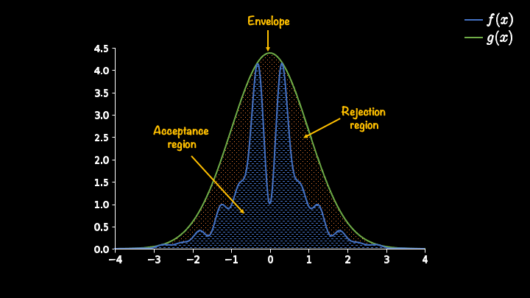
Rejection Sampling
Selecting the appropriate proposal function & finding its scaling constant
Requires that the PDF of the target function is known
Generally inefficient especially in higher dimensions

Slide 5
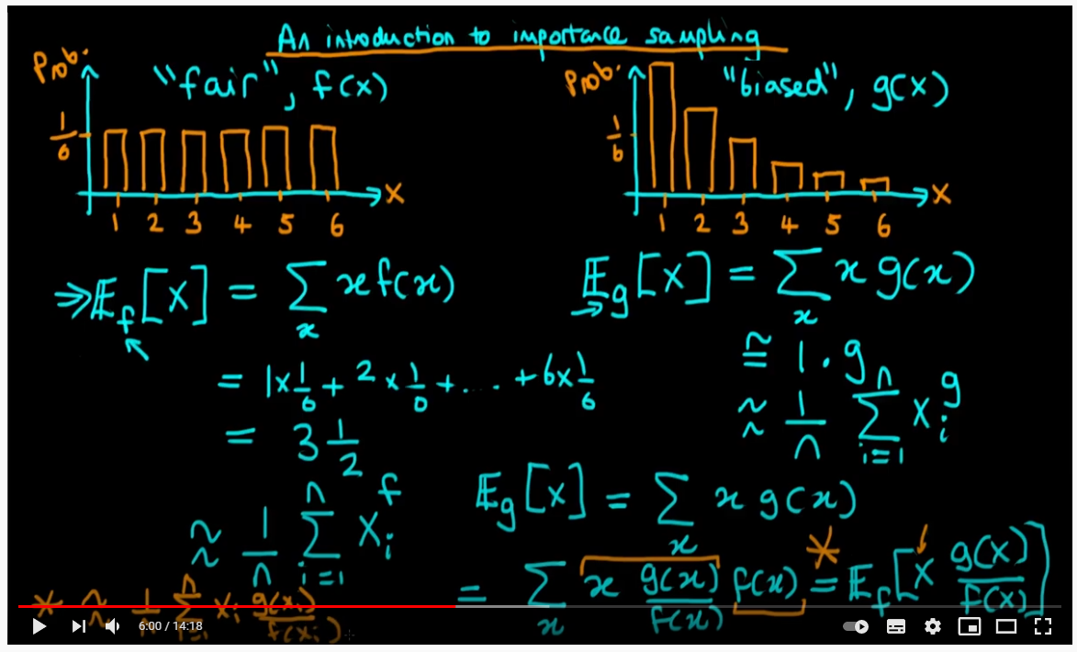
An Introduction to Importance Sampling --- by Ben Lambart

Slide 6

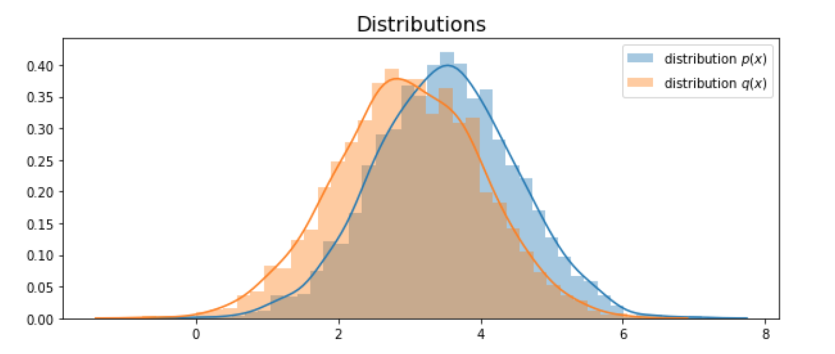
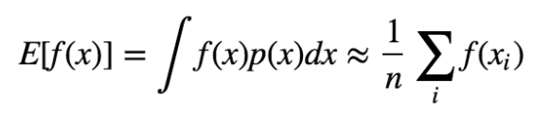
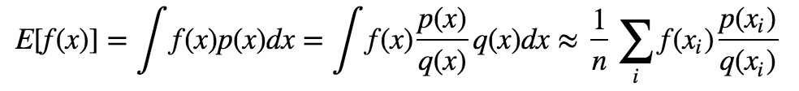

Slide 7
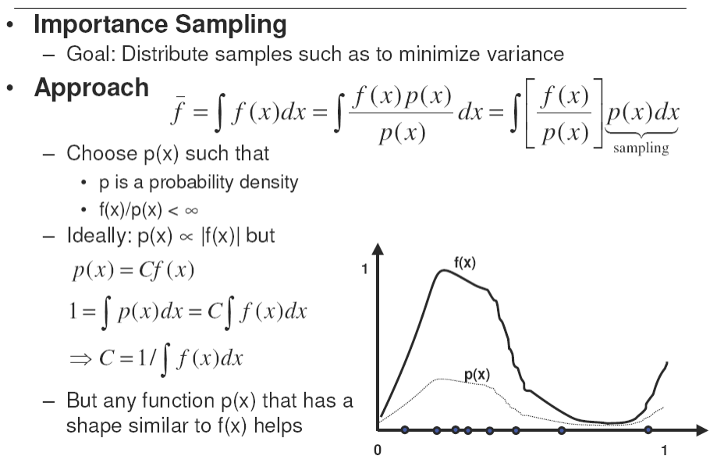

Slide 8
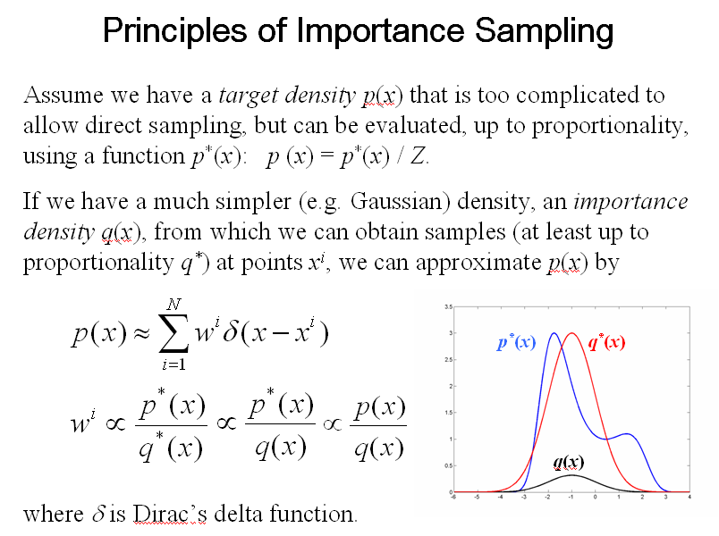
Importance Sampling

Slide 9
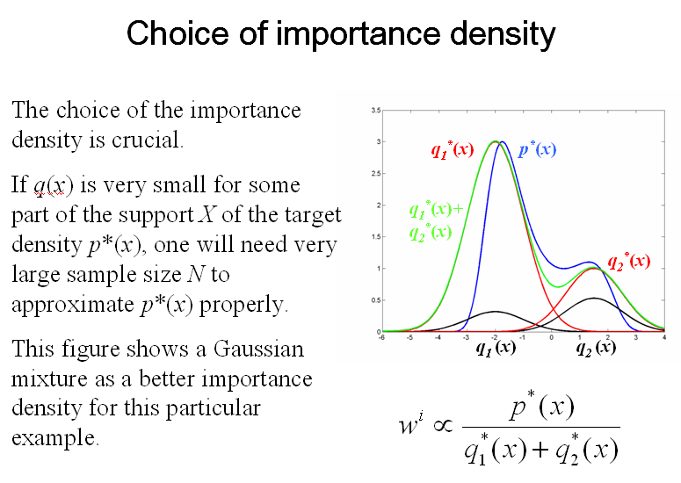
Importance Density

Slide 10
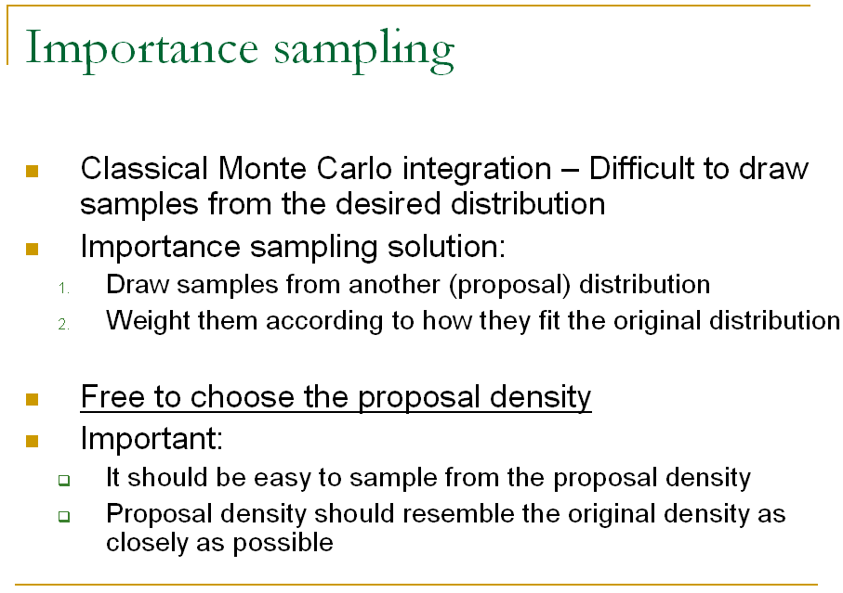
Importance Sampling

Slide 11

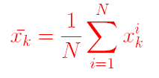



Sequential Importance Re-sampling/Particle Filter

Slide 12
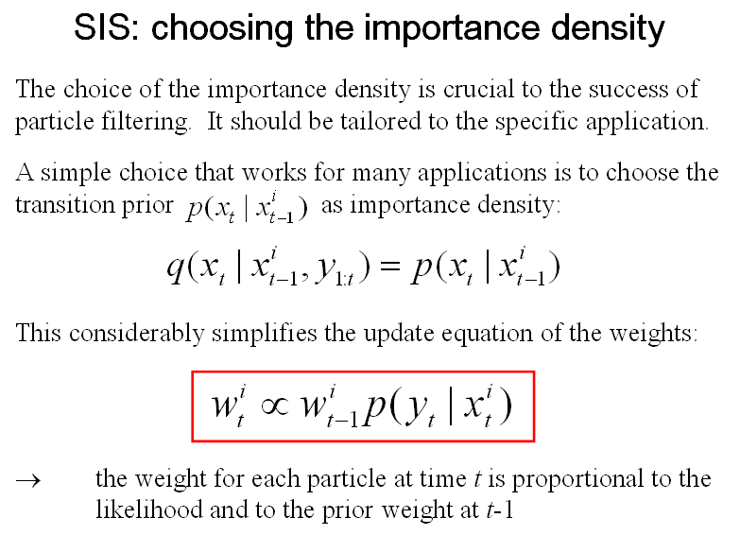
Importance Density

Slide 13
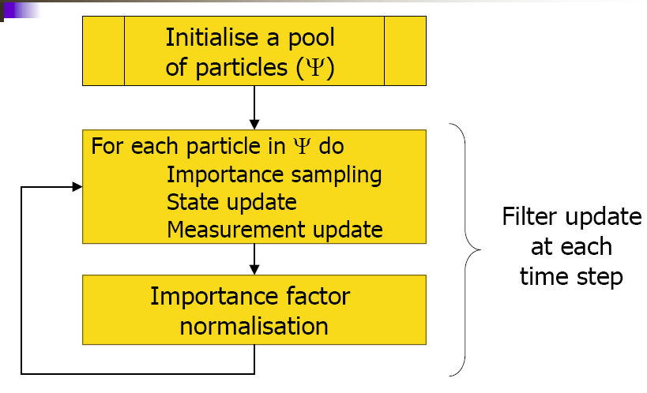
The Particle Filter Concept

Slide 14
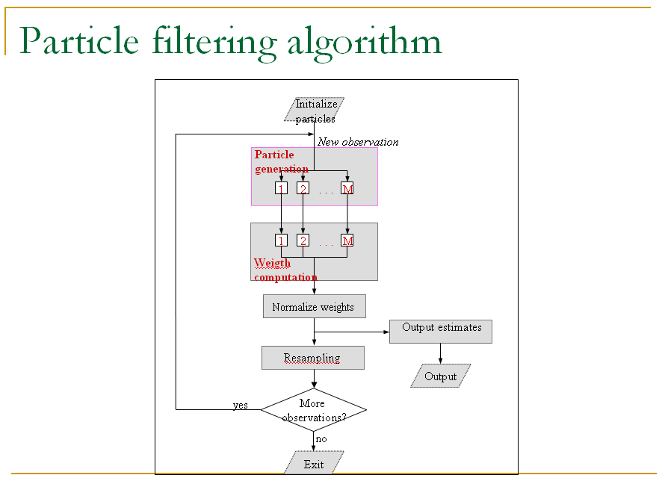

Slide 15
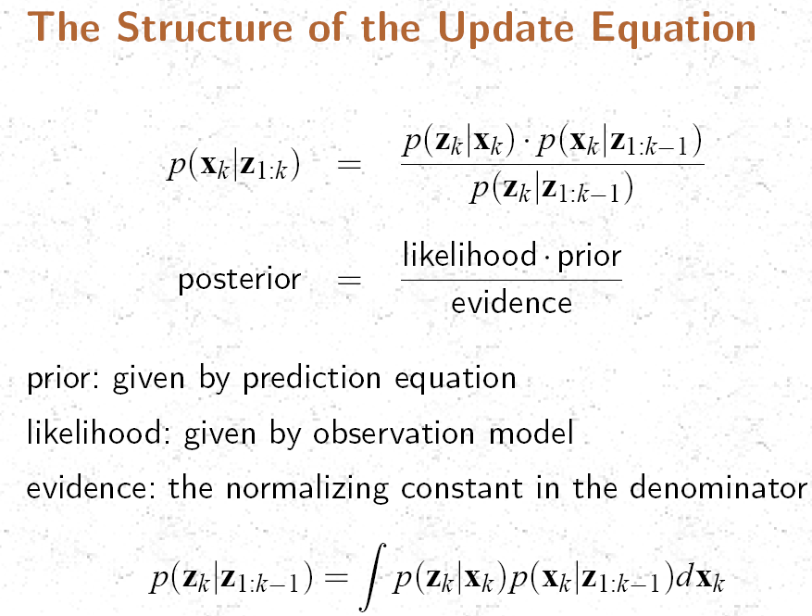


Slide 16


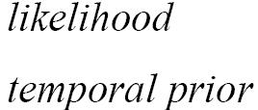

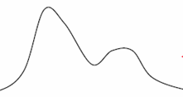
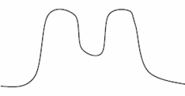
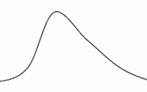

Slide 17
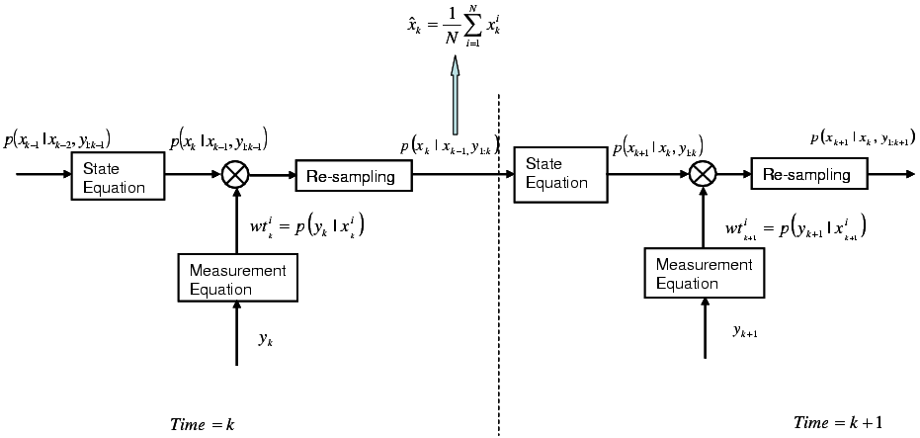
Sequential Importance Re-sampling/ Particle Filter

Slide 18
Initialisation, t = 0; (Prior Step)
For i = 1, …., N, sample x(0) ~ p{x(0)} & set t = 1
Importance Sampling
  Prediction Step
  For i = 1,…,N, sample x(t,i) ~ p{x(t)|x(t-1, i)}
  Likelihood Step
  For i = 1,…,N, evaluate importance weights : w(t,i) = p{z(t)|x(t,i)
  Normalise the Importance Weights
Selection
  Update Step/Resampling Step
  Resample with replacement, according to Importance Weights
  Set t = t + 1 and return to Prediction Step

